Slide 1
Security and Encryption on the Internet

Slide 2
Encryption
Virtual Private Networks
Firewalls
Web Design Tips to Avoid Attacks

Slide 3
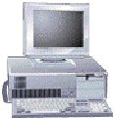
What is Encryption?
Have a nice day…
Encryption software running on sending computer
E%$&:”}{|…
Decryption software running on Receiving computer
Have a nice day…

Slide 4
Encryption
Cryptography
The process of converting a message into a secret code and changing the encoded message back to regular text
Encryption
The original conversion of a message into a secret code
Digital Signature
An encryption technique used for online financial transactions

Slide 5
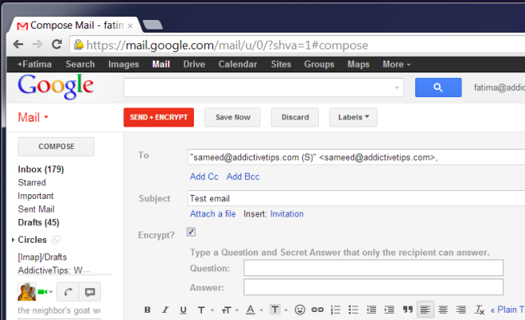
Encrypt Email

Slide 6
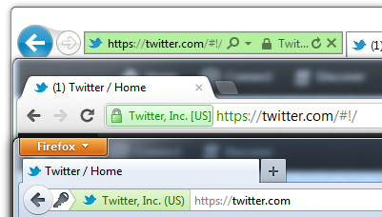
Encrypt web pages
https means “secure” traffic is encrypted. Passwords and sensitive data should always be encrypted.
http is a “clear text” transmission that can be intercepted by packet sniffers.
Most websites that handle user data (facebook, gmail, twitter etc) use encrypted data.

Slide 7
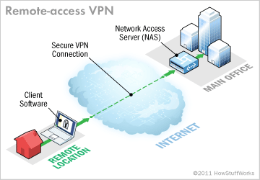
Virtual Private Network (VPN)
Virtual Private Network (VPN)
A secure connection between two points across the Internet
It allows you to be virtually connected to your company or school network using the Internet as a connection.

Slide 8
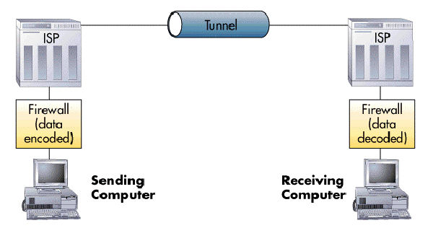
Tunneling
The process by which VPNs transfer information by encapsulating traffic in IP packets and sending the packets over the Internet

Slide 9
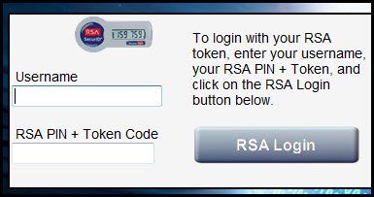
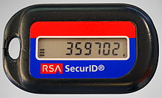
VPN passwords
Many VPN users must user two passwords (1) their personal password and (2) a constantly changing token that is generated by a keychain.

Slide 10
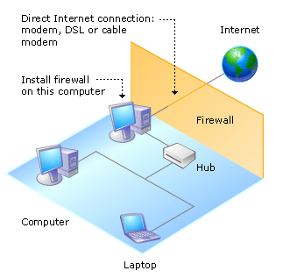
Firewalls
Protect your computer(s) from outside access.
A Packet filter: Looks at each packet entering or leaving the network and accepts or rejects it based on user-defined rules

Slide 11
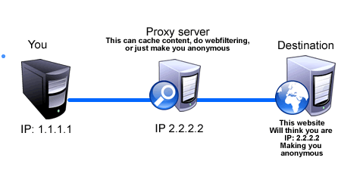
Firewalls
Proxy server: Intercepts all messages entering and leaving the network. The proxy server effectively hides the true network addresses.

Slide 12
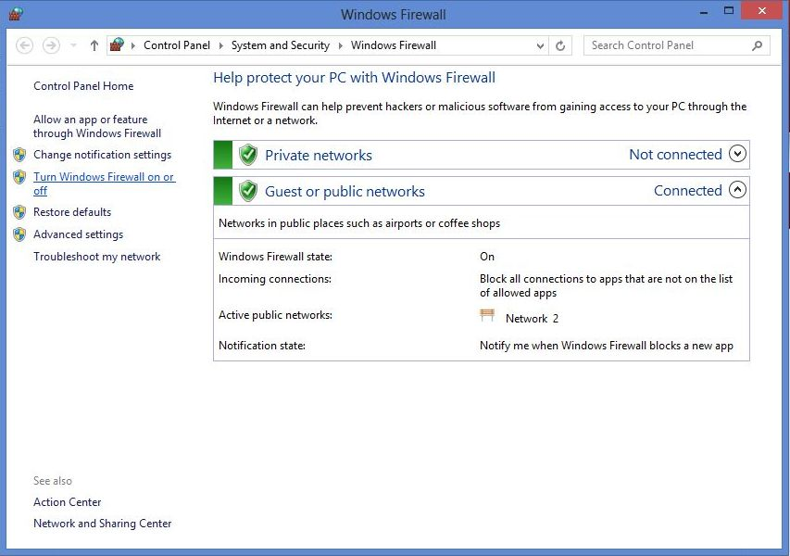
Windows Firewall Control Panel

Slide 13
Tips to keep your site from being hacked…
Keep software up to date.
Content Management Systems (Joomla, Drupal)
Server applications (IIS or Apache)
Database server (MySQL)
JavaScript plugins (jQuery)

Slide 14
Tips to keep your site from being hacked…
2. Avoid SQL injection attacks
Even if you don’t know SQL commands (yet), be aware that SQL statements can be hijacked by attackers.
When you start using SQL, be sure to research ways to avoid attacks.

Slide 15
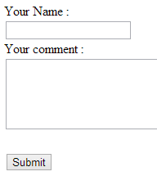
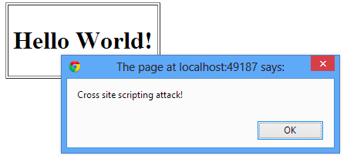
Tips to keep your site from being hacked…
3. Validate forms to ensure users don’t input HTML when you are expecting plain text…
2.
3.
1.
The user types this in the comments…
<h1>Hello World!</h1>
<script>
alert('Cross site scripting attack!');
</script>
The program then proceeds to display the comments and executes the JavaScript <script>

Slide 16
Tips to keep your site from being hacked…
4. Enforce secure passwords
More than 8 characters
Use numbers, symbols and capitalization.

Slide 17
Cracking Excercise
http://www.studyoffice.org/index.php?option=com_content&view=article&id=33:password-cracking-101&catid=19&Itemid=187

Slide 18
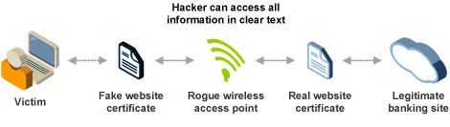
WIFI Attacks
Man in the Middle attack (MITM)
Setup your phone as a wifi access point such as “AirportWIFI”.
Wait for users to join.
Collect all of their packets while forwarding their requests to the internet.

